Slide 1
Chapter 4
System Analysis And Design
Process Specification

Slide 2
Process Specification
. Once a DFD is obtained the next step is to precisely specify the process
Structured English, Decision tables and Decision Trees are used to describe process.
Decision Trees are used when the process is logically complex involving large number of conditions and alternate solutions
Decision Table are used when conditions to be tested must follow a strict time sequence.

Slide 3
Data Dictionary
A data dictionary is a structured repository of data elements in the system. It stores the descriptions of all DFD data elements that is, details and definitions of data flows, data stores, data stored in data stores, and the processes.
Sr.No. | Data Name | Description | No. of Characters
1 | ISBN | ISBN Number | 10
2 | TITLE | title | 60
3 | SUB | Book Subjects | 80
4 | ANAME | Author Name | 15

Slide 4
Decision Trees
A decision tree is a tree that indicates conditions and actions in a simplified and orderly manner. By presenting logical alternative courses of action under various operating conditions, a decision table enables an individual to think through a problem and present its solution in compact notation.
Decision tree are used to model complicated logic. They can make it easy to see that all possible combinations of conditions have been considered and when conditions are not met, it is easy to see.
The major limitation of a decision tree is that it lacks information in its format to describe what other combinations of conditions you can take for testing. It is a single representation of the relationships between conditions and actions.

Slide 5
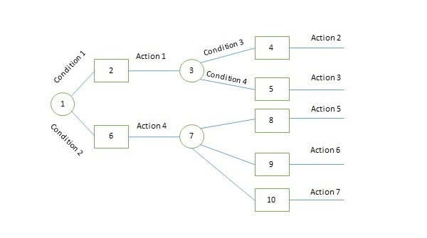
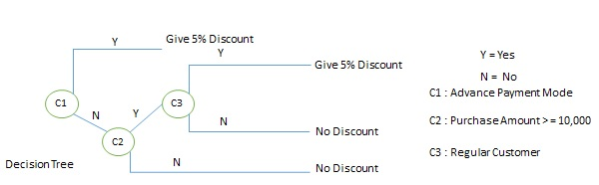
Decision Trees

Slide 6
Decision Table
Decision tables are a method of describing the complex logical relationship in a precise manner which is easily understandable.
  It is useful in situations where the resulting actions depend on the occurrence of one or several combinations of independent conditions.
  It is a matrix containing row or columns for defining a problem and the actions.
Components of a Decision Table:
  Condition Stub − It is in the upper left quadrant which lists all the condition to be checked.
  Action Stub − It is in the lower left quadrant which outlines all the action to be carried out to meet such condition.
  Condition Entry − It is in upper right quadrant which provides answers to questions asked in condition stub quadrant.
  Action Entry − It is in lower right quadrant which indicates the appropriate action resulting from the answers to the conditions in the condition entry quadrant.

Slide 7
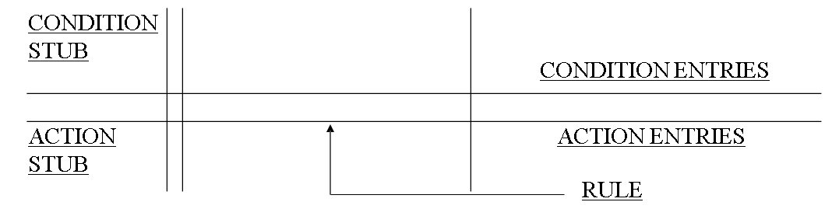
Decision Table Notation Explained
4 Quadrants-demarcated by two double lines
CONDITION STUB LISTS ALL CONDITIONS TO BE CHECKED
ACTION STUB LISTS ALL ACTIONS TO BE CARRIED OUT
LIMITED ENTRY DECISION TABLE:ENTRIES ARE Y or N or -.Y-YES,N- NO,-IRRELEVANT(DON’T CARE)
X against action states it is to be carried out. -against action states it is to be ignored.
The entries in decision table are given by Decision Rules which define the relationships between combinations of conditions and courses of action. In rules section,
  Y shows the existence of a condition.
  N represents the condition, which is not satisfied.
  A blank - against action states it is to be ignored.
  X (or a check mark will do) against action states it is to be carried out.

Slide 8
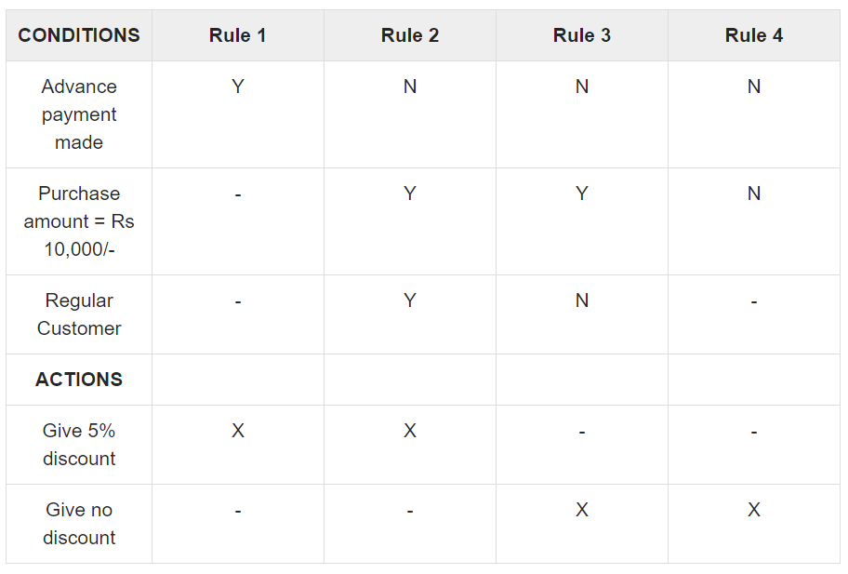
Decision Table

Slide 9
Structured English
Structured English is similar to a programming language such as Pascal
It does not have strict syntax rules as programming language
Intention is to give precise description of a process
The structured English description should be understandable to the user

Slide 10
Example: Structured English
if customer pays advance then
Give 5% Discount else
if purchase amount >=10,000 then
if the customer is a regular customer
then Give 5% Discount else No Discount
end if
else No Discount end if
end if

Slide 11
Decision Table For
Shipping Rules
 |  | R1 R2 | R3 | R4
C1: Qty ordered <= Quantity in stock? |  | Y Y | N | N
C2: (Qty in stock-Qty ordered)<=reorder level |  | N Y | - | -
C3: Is the partial shipment ok? |  | - - | Y | N
A1:Qty shipped=Qty ordered A2:Qty shipped=Qty in stock A3:Qty shipped=0 A4:Qty in stock=0 A5:Back order=qty ordered- qty shipped A6:Initiative reorder procedure A7: Qty in stock€Qty in stock -Qty shipped |  | X X | - | -
 |  | - - | X | -
 |  | - - | - | X
 |  | - - | X | -
 |  | - - | X | X
 |  | - X | X | X
 |  | X X | - | -

Slide 12
Comparison of Structured English, Decision Tables and Decision Trees
CRITERION FOR COMPARISON | STRUCTURED ENGLISH | DECISION TABLES | DECISION TREES
ISOLATING CONDITIONS & ACTIONS | NOT GOOD | BEST | GOOD
SEQUENCING CONDITIONS BY PRIORITY | GOOD | NOT GOOD | BEST
CHECKING FOR COMPLETENESS , CONTRADICTIO N & AMBIGUITIES | NOT GOOD | BEST | GOOD

Slide 13
When To Use Structured English, Decision Tables and Decision Trees
Use Structured English if there are many loops and actions are complex
Use Decision tables when there are a large number of conditions to check and logic is complex
Use Decision trees when sequencing of conditions is important and if there are not many conditions to be tested

Slide 14
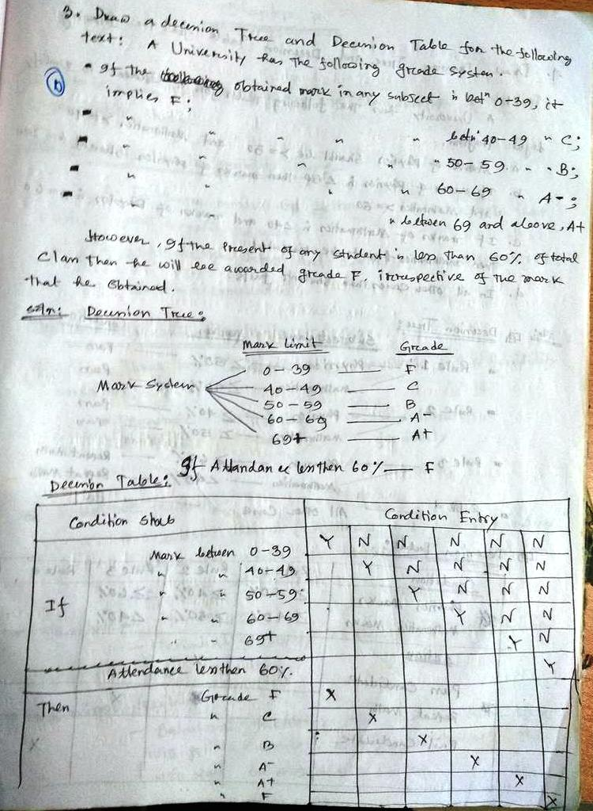
Example-1:
Draw a decision tree and decision table for the following text.
A university has the following grade system.
If the obtained mark in any subject is between 0-39, it implies F;
If the obtained mark in any subject is between 40-49, it implies C;
If the obtained mark in any subject is between 50-59, it implies B;
If the obtained mark in any subject is between 60-69, it implies A;
If the obtained mark in any subject is between 69 and above, it implies A+;
However, if the present of any student is less than 60% of total class then he/she will be awarded grade F, irrespective of the mark that he obtained.

Slide 15
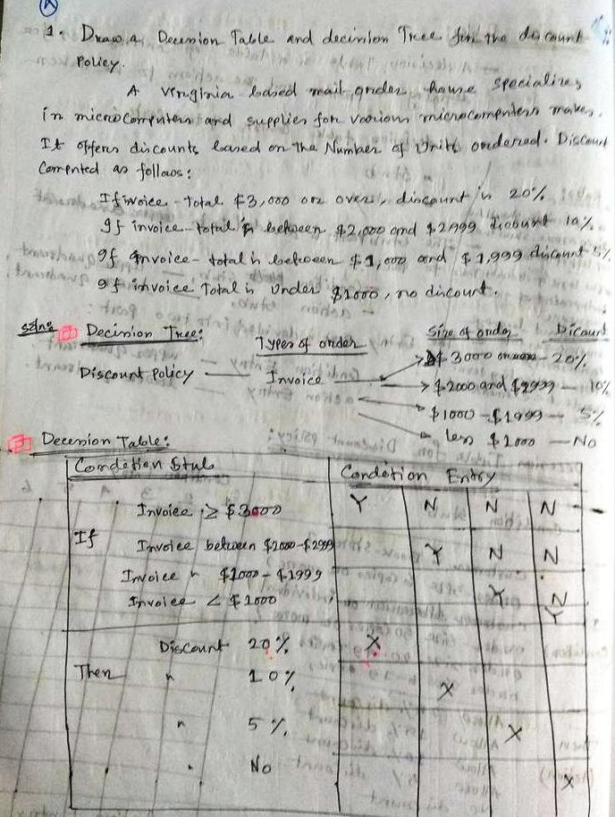
Example-2
Draw a decision tree and decision table for the following text.
A Virginia based mail order house specializes in microcomputers and supplies for various microcomputer makes. It offers discount based on the number of units ordered. Discount computed as follows:
If invoice total $3,000 or over discount is 20%.
If invoice total is between $2,000 and $2999 discount is 10%.
If invoice total is between $1,000, and $1,999, 5% discount.
If invoice total under $1,000, no discount.

Slide 16
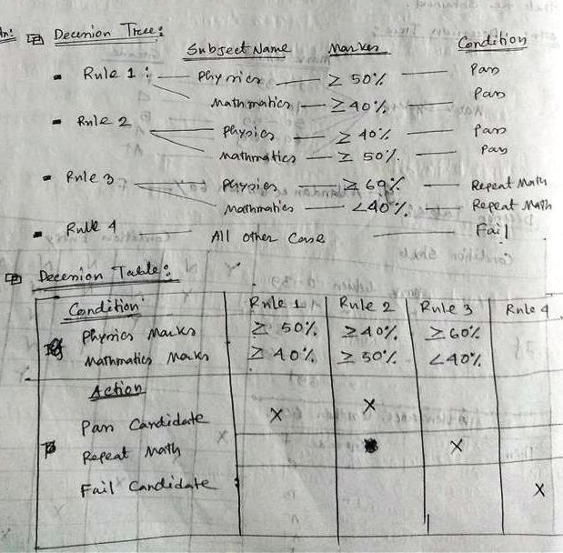
Example-3
Draw a decision tree and decision table for the following text.
A university has the following rules for a student to qualify degree program.
Marks of Physics should be >=50 and Mathematics >=40
If marks of Physics is <50 then marks of Physics should be >40 and Mathematics >=50.
If marks of Mathematics is <40 and marks of Physics is >=60 then Mathematics has to be repeated.
In all other cases the students fails.

Slide 17
References
System Analysis and Design, by Elias M. Awad
Systems Analysis and Design, Kendall and Kendall, Fifth Edition
Structured Analysis
  https://www.tutorialspoint.com/system_analysis_and_design/system_analysis_and_design_structured.htm

